Slide 1
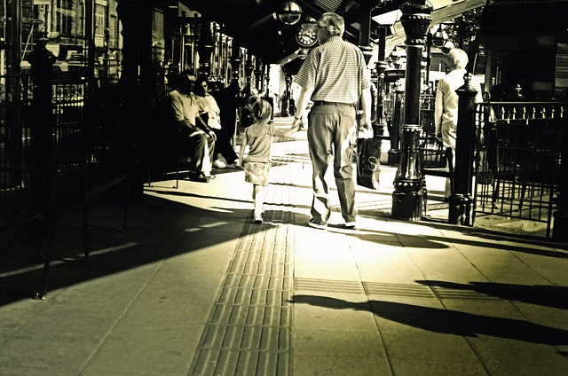
People who help us

Slide 2
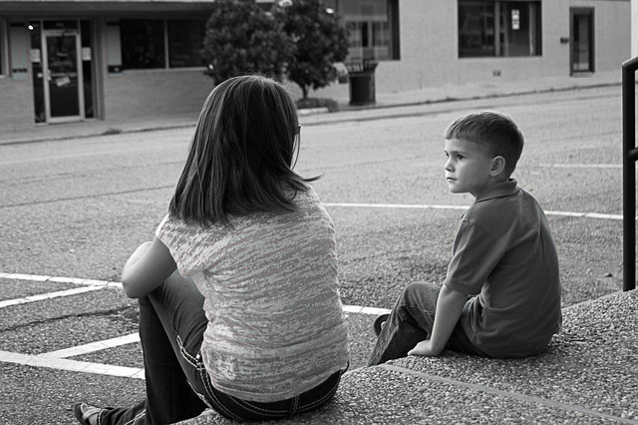
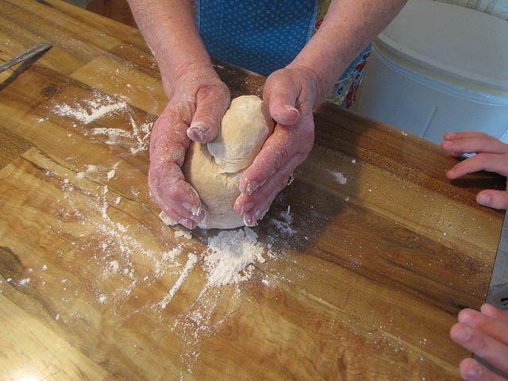
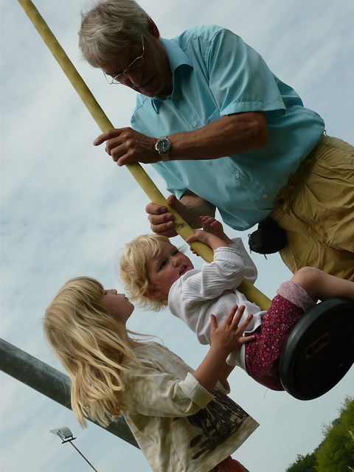
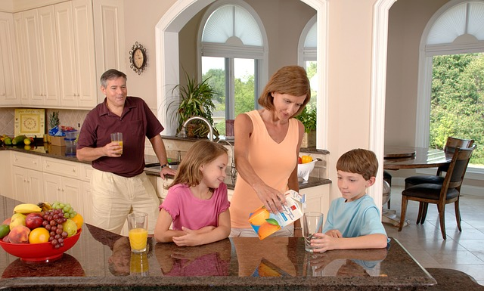
People in our families Help us

Slide 3
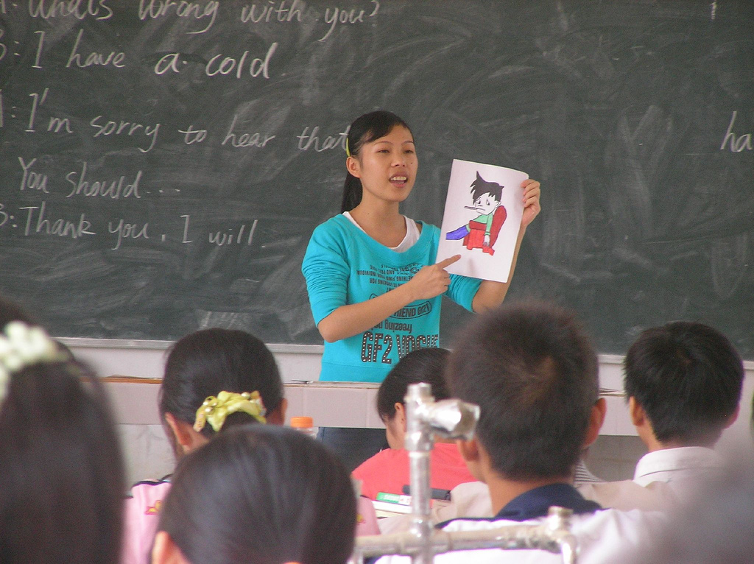
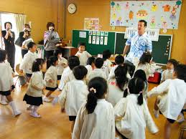
How do teachers help us?

Slide 4
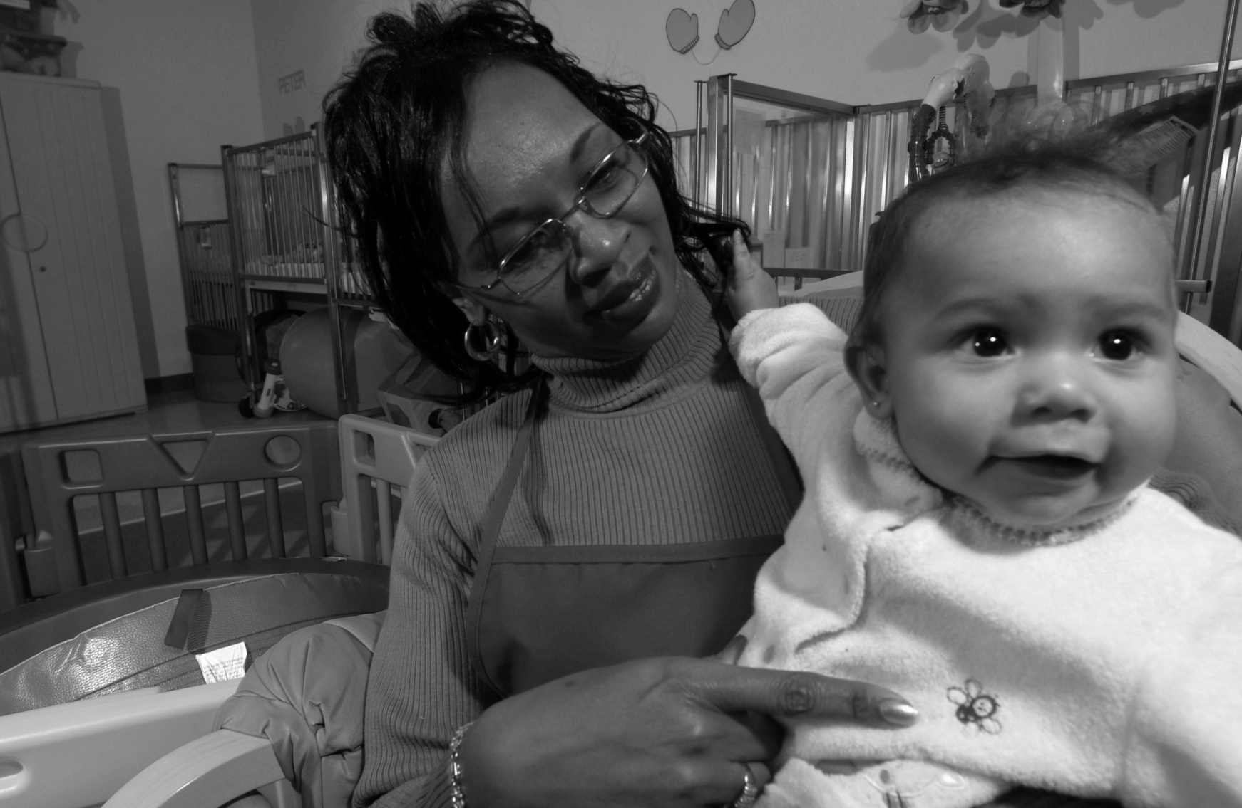
Do any of you stay with a childminder? How do they help?

Slide 5
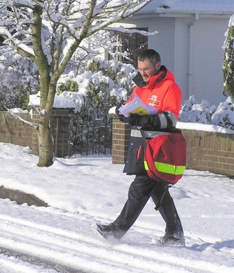
How does this person help?

Slide 6
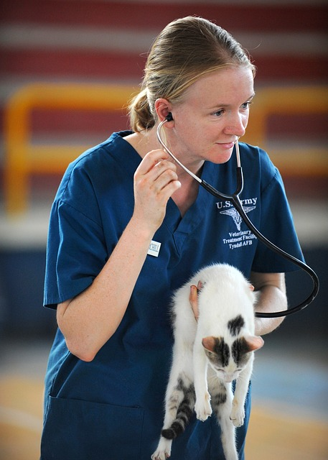
How do veterinarians (vets) help us?

Slide 7
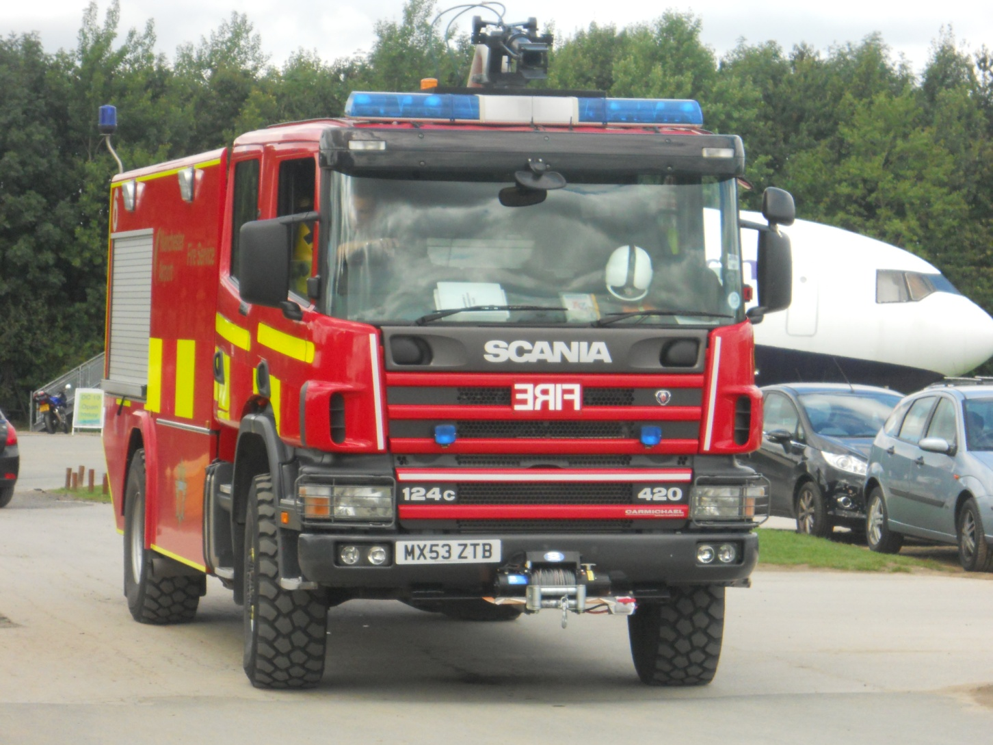
Who are these helpers?
What do they do?

Slide 8
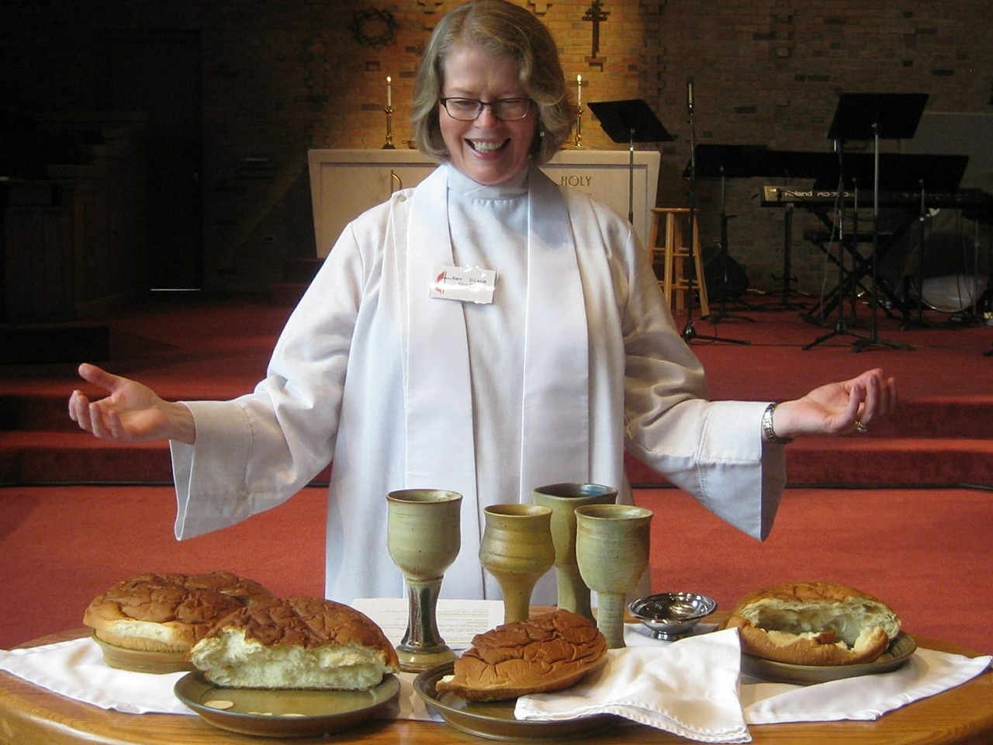
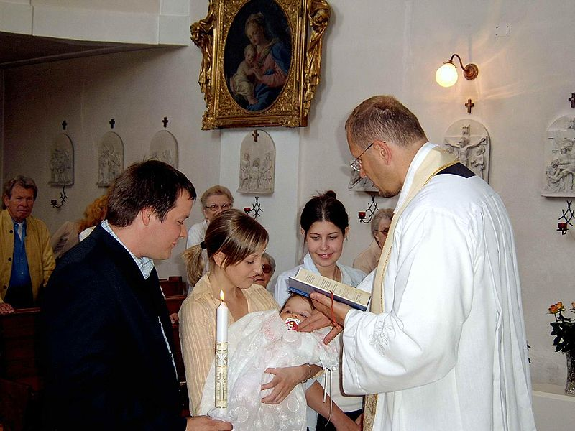
These are religious leaders. They can be called priests, vicars, ministers,
pastors ...
What are some things these people do to help us?

Slide 9
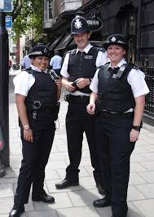
Do you know what these people do to help?

Slide 10
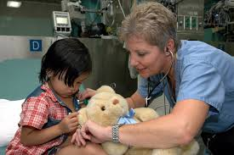
How do nurses help people?

Slide 11
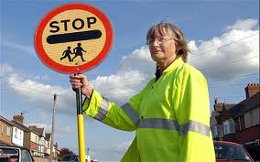
This is a crossing guard, or a ‘lollipop lady’. How do they help children?

Slide 12
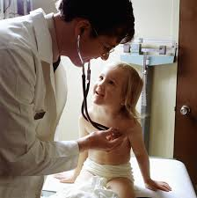
Have you been to see a doctor?
How did he or she help you?

Slide 13
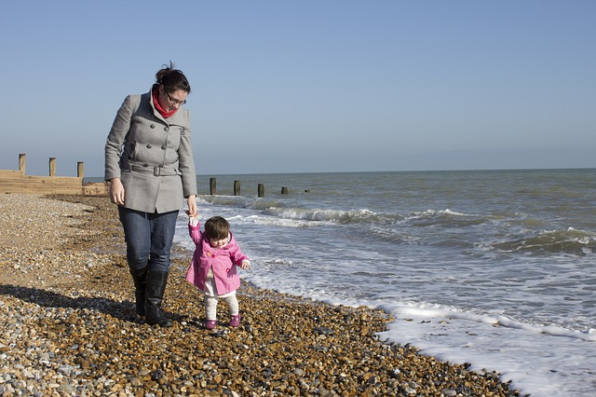
Can you think of someone else who helps Children?

